Slide 1
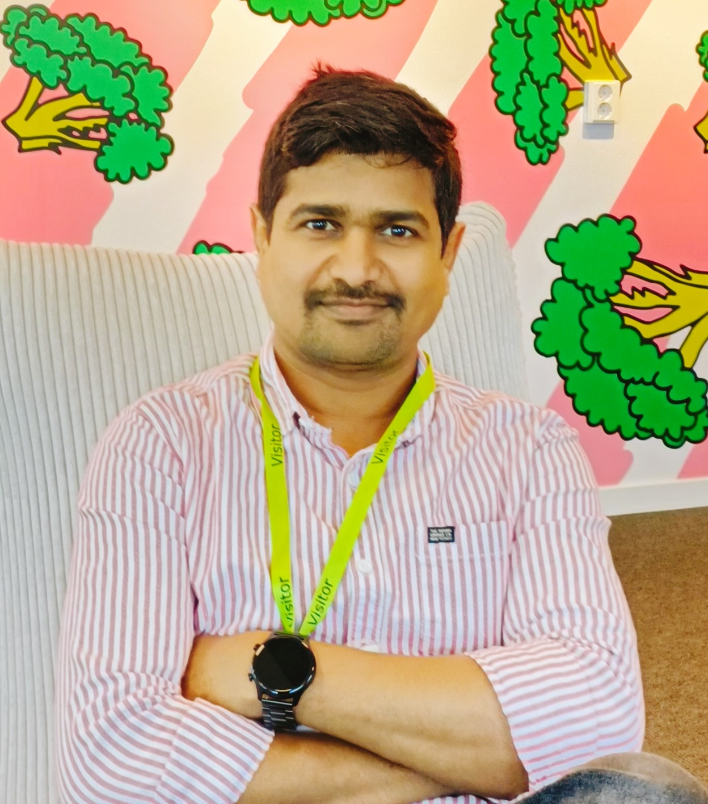


WORK EXPERIENCE
Results-oriented Dotnet developer with 9+ years of experience designing, developing, and maintaining enterprise-grade applications
across .NET, .NET Core, C#, JavaScript, API, PL/SQL in Azure and on-prem environments at IKEA. Proven success in building scalable cloud based microservices, driving digital transformation, and automating workflows to enhance operational efficiency. Adept at cross functional collaboration, agile delivery, and delivering measurable business out comes.
What I Bring to SEB
Application Development: Migrated large-scale legacy systems to .NET Core microservices, improving scalability, security, and maintainability.
Full lifecycle ownership of applications: covering feature development, testing, deployment, release management, maintenance, monitoring, and continuous improvement of application quality.
API Engineering: Designed and implemented REST APIs for seamless integration with internal and external systems, enabling faster data exchange and customer-centric solutions.
Performance & Quality: Hands-on experience writing complex SQL queries, stored procedures, fine-tuning long-running queries, and setting up monitoring tools like Splunk, Catchpoint, and AppDynamics to track application logs and proactively identify and resolve production issues improving reliability and overall application quality.
DevOps & Automation: Built CI/CD pipelines in Azure DevOps and Jenkins, automated deployments using PowerShell and Docker, reducing release cycles and operational risk.
Problem-Solving & Adaptability: Strong analytical and critical thinking skills with the ability to adapt quickly to changing priorities and environments, ensuring timely and effective delivery
Leadership & Collaboration: Led a 7-member offshore team, driving delivery excellence through mentorship and coordination. Skilled at balancing individual contributions with team collaboration to achieve shared goals.
Recognition & Impact: Multiple client appreciations for identifying and implementing automation solutions for frequent user requests and successfully managing complex initiatives like database migrations with zero business disruption.
Why SEB Choose Me
I can quickly adapt to new environments, understand business processes, and translate them into meaningful technical requirements to deliver trusted, standardized solutions
I bring a proactive mindset with strong organizational skills and the ability to connect technical solutions to business objectives for measurable impact.
I focus on user experience and continuous learning, ensuring every solution adds value beyond coding and aligns with overall business goals.
With over 9 years working at IKEA, including 4 years in Sweden, I have contributed to multiple assignments across Range and Supply Chain development, proving my ability to work effectively in diverse teams. I believe I can be a strong cultural and technical fit, combining collaboration, adaptability, and a positive approach to achieve shared success.
Appala naidu K
Consultant
+46-764337018
Appalanaidu.kolli@tcs.com
Dammsnäcksgrand 13 c, Malmö, Sweden
SKILL SET
Programming & Frameworks:
C# (.NET), Asp. Net Core, Angular, PL/SQL & JavaScript
Cloud & DevOps/ Tools:
Microsoft Azure, Git, GitHub, CI/CD Docker and Kubernetes
BI & Analytics Tools:
PowerBI, Python, SQL
Databases:
SQL Server, MySQL , Postgres, MongoDB(Basics)
CERTIFICATIONS
TCS-Wings2: Dot Net Full Stack Developer with Angular Specialization
Certified Scrum Master
Digital: Cloud DevOps
EDUCATION
Master of Computer Applications (M.C.A)
Andhra University, India.
TCS Confidential

Slide 2
PROJECT HIGHLIGHTS
Full Stack Engineer & Analyst| TCS-IKEA Supply | 2023 – Present Älmhult,Sweden
GS1 Standards embracing to IKEA Supply chain
Functional Expertise:
Embracing GS1 Standards into IKEA digital ecosystems, master data standardization, modernizing the existing digital platforms, compliance adherence, sustainability initiatives, improvising product traceability in value chain
Technical Impact:
Designed and developed business applications using .NET, C#, Angular, PL/SQL to support IKEA GS1 transformation journey.
Led maturity assessments and impact analyses integrating GS1 standards into IKEA digital ecosystems, demonstrating analytical and detail-oriented skills.
Built secure REST APIs and microservices to support compliance verification systems.
Enhanced platform security with robust authentication, authorization, and standardized logging/monitoring.
Design and developed database store procedures, fine tuned complex queries, implimented automated reports to monitor product master data changes.
Application Management & Support (AMS Lead, DevOps Engineer)| TCS-IKEA Range | 2017 – 2023
Älmhult, Sweden & Chennai, India
Functional Expertise:
Retail operations, business applications management & end-to-end ownership, stakeholder management, infrastructure governance, SLA governance, lean process improvement, monitoring, performance tuning, automating user requests
Technical Impact:
Designed and developed 40+ enterprise applications using C#, .NET Core, Angular, PL/SQL, and PostgreSQL, improving scalability and maintainability through continuous enhancements and adherence to SDLC.
Built health monitoring dashboards with Splunk and AppDynamics, increasing proactive issue detection and system reliability by 30%.
Automated recurring user requests by developing a Service Request Engine, reducing lead times by 20% and saving €100K annually.
Implemented CI/CD pipelines in Azure DevOps and Jenkins, enabling faster and more reliable deployments across multiple environments.
Led Oracle 12c to 19c database migration, coordinating 20+ cross-functional teams to ensure zero business disruption during all phases.
Fine-tuned long-running SQL queries and optimized database jobs, improving performance and operational stability.
Proactively identified and decommissioned 30 unused Windows and database services, resulting in €1M cost savings.
Developed structured logging and monitoring strategies using Splunk, Catchpoint, and AppDynamics to improve application quality and prevent production issues.
Received Contextual Master Award for designing an automation solution that fixed a critical pricing logic flaw, generating €2M in business savings.
TCS Confidential

